Slide 1
This is a 6-story steel frame. The structure was tested on NCREE shaking table.
Seven different types of member cutting was embedded in this structure (cut was only applied to the 1st and 2nd floors).
From the following slide, test case-1 is the undamaged structure (No cut) and test case-8 is the most sever damage (with significant cut in the lower floors).
Each floor was mounted with 3 accelerometers.
Only test case 1 (no damage) and test case 8 data (most severe damage) will be used in this study.
The sampling rate of the data is 200 Hz.
The identified system dominant frequencies are also shown in the slide. The change of modal frequencies for the damage test case-8 are only appeared in higher modes.

Slide 2
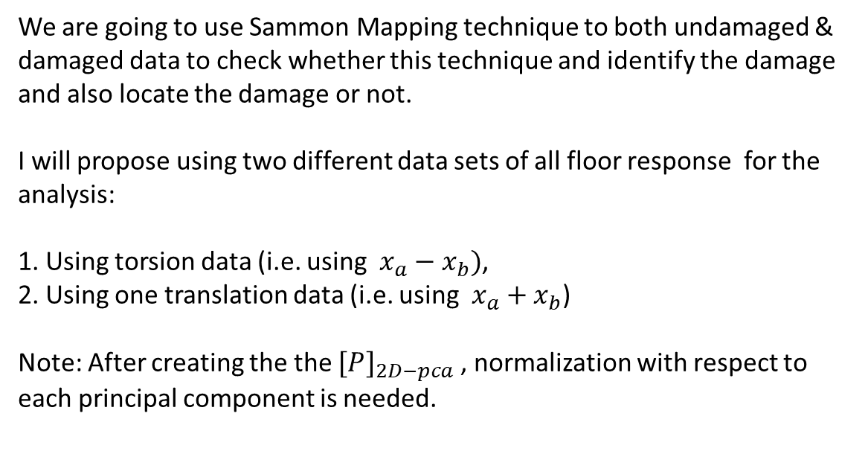
We are going to use Sammon Mapping technique to both undamaged & damaged data to check whether this technique and identify the damage and also locate the damage or not.
I will propose using two different data sets of all floor response for the analysis:
1. Using torsion data (i.e. using $x_{a}−x_{b})$,
2. Using one translation data (i.e. using $x_{a}+x_{b}$)
Note: After creating the the $[P]_{2D−pca}$ , normalization with respect to each principal component is needed.

Slide 3
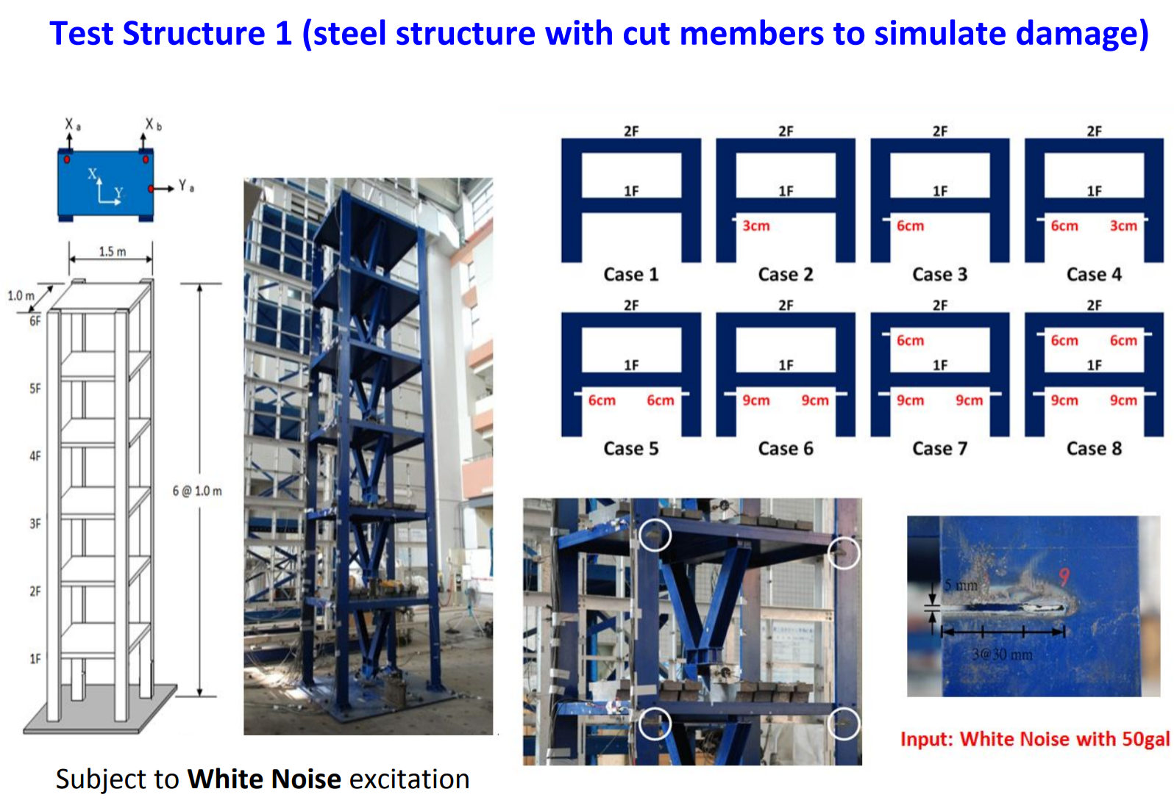

Slide 4
